Slide 1


SMART WRISTBAND

Slide 2
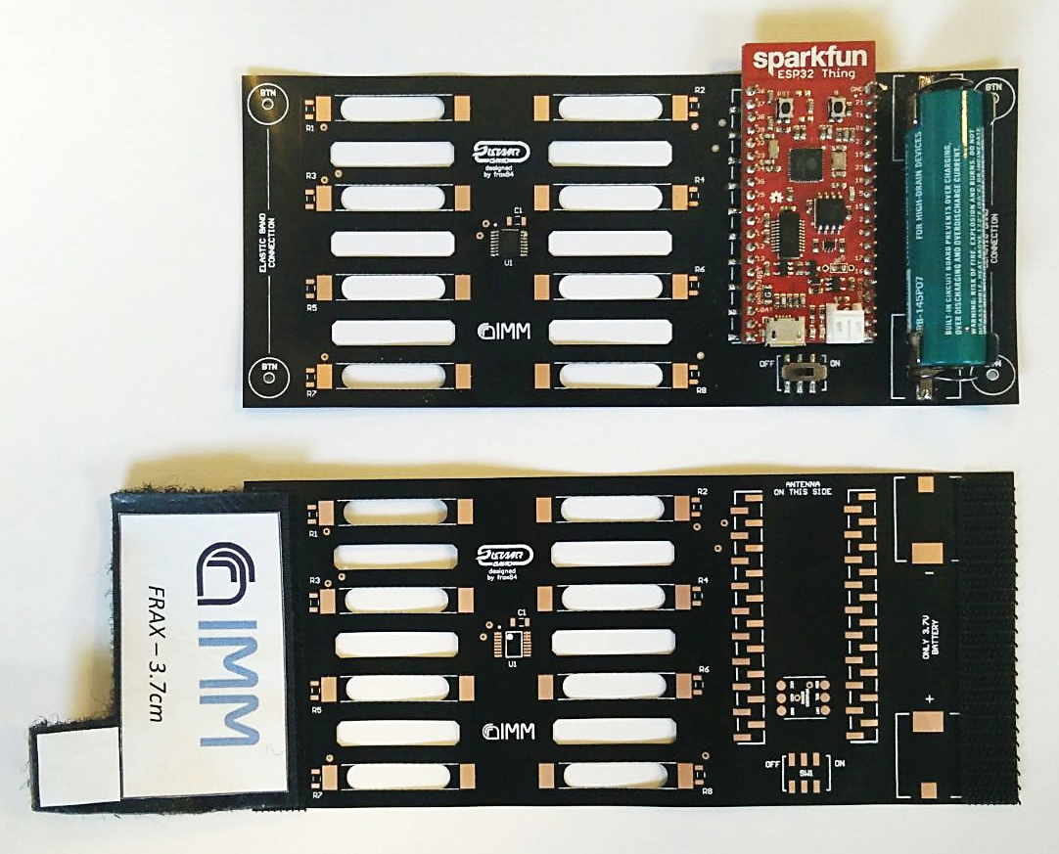
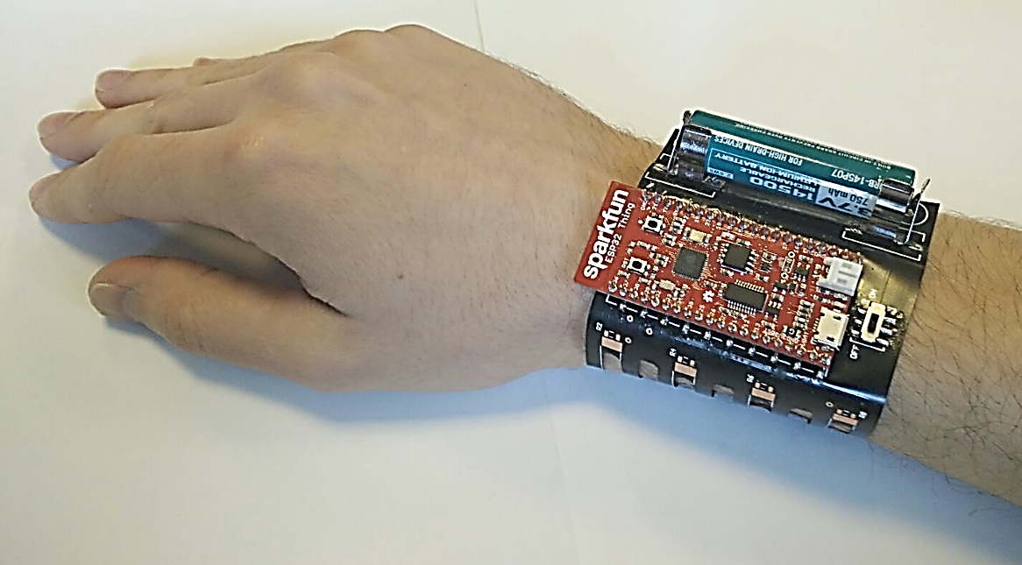
SYSTEM OVERVIEW
Flex PolyImide 2layers PCB (thickness<120um)
Central unit (CPU + BLE transreceiver)
Li-Ion rechargeable battery (3.7V)
Slot for CTPE strain gauges
Closing velcro adapter

Slide 3
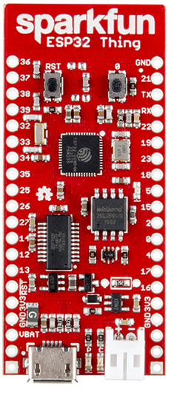
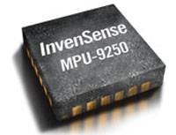



FEATURES OVERVIEW
Espressif ESP32:
Dual-core microprocessor @180MHz (up to 240MHz)
520kB internal SRAM
802.11 b/g/n WiFi transceiver
dual-mode Bluetooth (classic and low energy)
2.5 µA deep sleep current
Up to 16 10bit ADC channels
Hardware accelerated encryption (AES, SHA2, ECC, RSA-4096)
4MB Flash memory
3mm
3mm
6cm
InvenSense MPU9250:
16bit accelerometer 3-axis (full range can be set to ±2g, ±4g, ±8g, ±16g) → resolution down to ~ 60 μg
16bit gyroscope 3-axis (full range can be set to ±250deg/s, ±500deg/s, ±1000deg/s, ±2000deg/s) → resolution down to ~ 8mdeg/s
16bit magnetometer 3-axis (full range ±4800μT) → resolution down to 0.6 μT/LSB
2.6cm

Slide 4
BLE COMMUNICATION DETAILS – 1
AVAILABLE DATA
ESP32Thing firmware has been developed to grant access to a series of data using standard Bluetooth Low Energy GATT architecture
SERVICE 1
MPU DATA
Accelerometer, Gyroscope and Magnetometer 3-axis data
(Notify toggle can be switched to reduce latency of data transfer)
DESCRIPTOR
(NOTIFY)
YPR DATA
Yaw, Pitch and Roll are calculated by sensor-fusion algorithm
(Notify toggle can be switched to reduce latency of data transfer)
DESCRIPTOR
(NOTIFY)
STRAIN DATA
8 channels, 10bit resolution (3.2mV/bit level)
(Notify toggle can be switched to reduce latency of data transfer)
DESCRIPTOR
(NOTIFY)
ACCEL CALIB
GYRO CALIB
Offset, sensitivities and cross sensitivities corrections of the Motion Programming Unit
MAG CALIB 1
MAG CALIB 2

Slide 5
BLE COMMUNICATION DETAILS – 2
DATA EXCHANGE
LABView client has been developed to allow data and setting exchange with the wristband
ESP32 - BLE GATT SERVER
LABVIEW - BLE GATT CLIENT
SERVICE 1
MPU DATA
READ
DESCRIPTOR
(NOTIFY)
ENABLE/DISABLE NOTIFY (WRITE)
READ
YPR DATA
ENABLE/DISABLE NOTIFY (WRITE)
DESCRIPTOR
(NOTIFY)
WRITE
ACCEL CALIB
WRITE
GYRO CALIB
WRITE
MAG CALIB 1
WRITE
MAG CALIB 2

Slide 6
BLE COMMUNICATION DETAILS – 3
DATA COMPRESSION
A simple algorithm for data compression has been developed in order to reduce both latency and power consumption.
BLE PACKET PAYLOAD = 20 BYTES
With no compression: YPR Data + StrainData →
→YPR = 4B x 3angles + StrainData =2B x 8channels → 28Bytes >20! Needed 2 transmissions (double latency and power)
With compression: YPR Data + StrainData →
→YPR = 1B x3angles + StrainData =10B →13Bytes
Compression introduce data loss in YPR resolution (error becomes ±0.7deg) and no loss in StrainData
POWER REDUCTION OF 35% for data transmission OR 7Bytes available for other sensors!

Slide 7
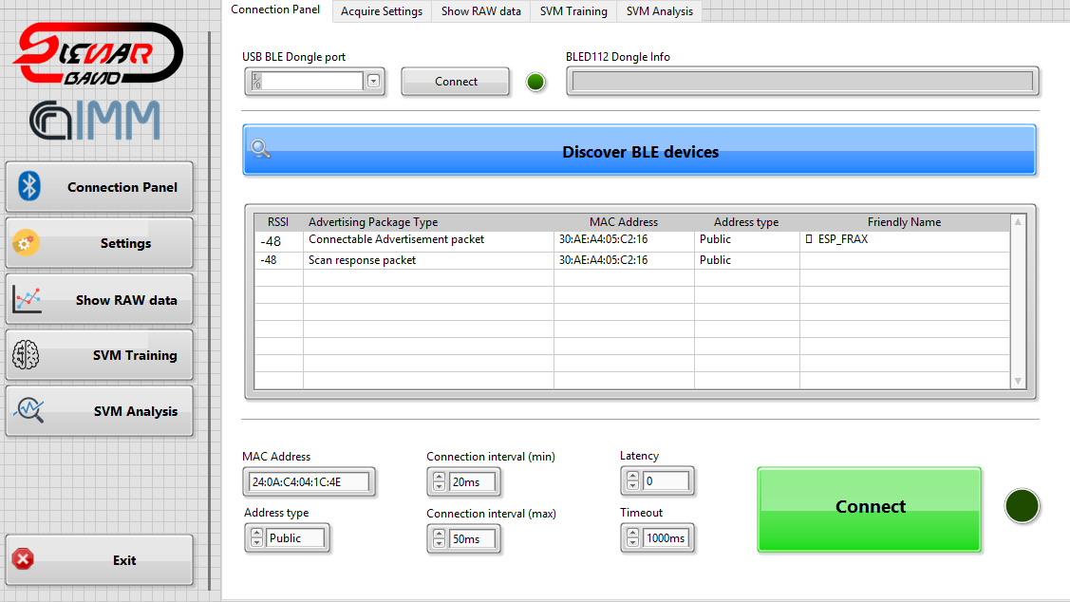
LABVIEW CLIENT
An advanced LABView client has been developed to manage the wristband.
The client is able to:
Connect to the device;
Fully implemented calibration routines for accelerometer, gyroscope and magnetometer;
Acquire/visualize/save sensor data;
Make data analysis to extract the main features of the signal acquired.
Under development:
Machine learning algorithm (SVM) to enable advanced data analysis (gesture recognition, signal classification)

Slide 8
STRAIN SENSOR READOUT
Ground muxing has been implemented together with proper ADC sample acquisitions in order to provide power consumption reduction.
V_{DD}
…….
Data transmission
ADC1 sampling
ch1
OFF
ON
OFF
to
ADC0
to
ADC1
…….
to
ADCn
ADC2 sampling
ch2
OFF
ON
OFF
ADCn sampling
chN
OFF
ON
OFF
MUX
Strain sensor branches are V_{DD} supplied just for the time needed to sample the channel with ADC. In this way each channel draws current for a time <0.5ms for each acquisition interval (~50ms), with a power consumption reduction up to 90% for strain gauge electronics.

Slide 9
YAW, PITCH and ROLL ESTIMATION
A sensor fusion algorithm (Madgwick’s algorithm) has been implemented in the ESP32Thing software. The algorithm uses the data provided by (calibrated) accelerometer, gyroscope and magnetometer to compute absolute orientation of the wristband in the 3D space. Fast movement detection can be enabled increasing the frequency sampling of the algorithm (iterative) at a cost of more computational power.
Accelerometer
data
Gravity
info
Madgwick’s
algorithm
Gyroscope
data
Transient
Correction info
ABSOLUTE
ORIENTATION
Magnetometer Data
North pole
direction

Slide 10
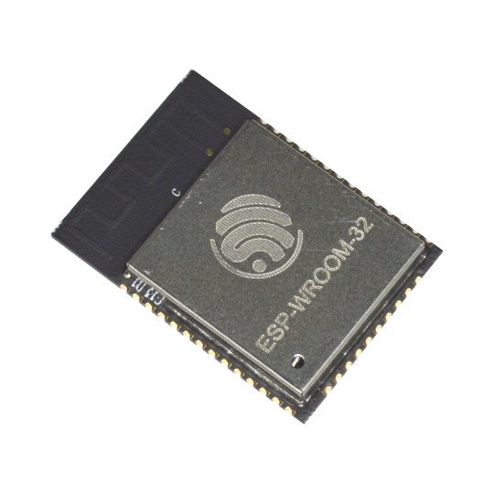
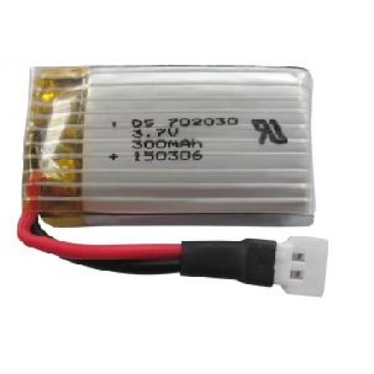
NEXT DEVELOPMENT
- A more integrated version of the wristband is highly feasable:
using ESP-WROOM-32 (same chip) that is 2.55 x 1.08cm vs 6 x 2.6cm of ESP32Thing
In the next future new APIs will implement. The consumption reduction will allow to use smaller and lighter battery (Li-Po)
More sensors can be embedded: piezoelectric capacitors, mioelectric electrodes, heartbeat sensors, etc.
Machine learning algorithm are going to be implemented in the LABView client to enable data classification and more advanced analysis

